Slide 1



Activity and memory in neuronal networks
Workshop - Introduction to Computational Neuroscience
Neurasmus : European Master in Neuroscience
2024 July 3rd - 6th, Amsterdam, Netherlands
Patrick Desrosiers
Dynamica Research Lab
CERVO Brain Research Center
Département de physique, de genie physique et d’optique, Université Laval

Slide 2
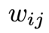
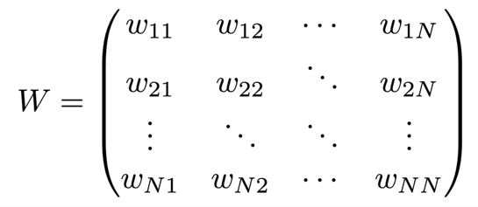
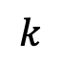
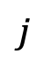
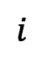
Reminder:
Neuronal networks are first modeled as weighted directed graphs
$$j$$
Synonyms:
Adjacency matrix
Weight matrix
Connectivity matrix
$$i$$
$$k$$

Slide 3

Neuronal activity models
Lapicque (1907)
Adrian (1926)
McCulloch & Pitts (1943)
Hodgkin & Huxley (1952)
Amari (1972)
Little (1974)
Wilson & Cowan (1972)
Cohen & Grossberg (1983)
Hopfield (1982 & 1984)
…

Slide 4
Neuronal activity models
Lapicque (1907)
Adrian (1926)
McCulloch & Pitts (1943)
Hodgkin & Huxley (1952)
Amari (1972)
Little (1974)
Wilson & Cowan (1972)
Cohen & Grossberg (1983)
Hopfield (1982 & 1984)
…
Will be presented and studied during out next computer lab:
Attractors and Hopfield networks.

Slide 5
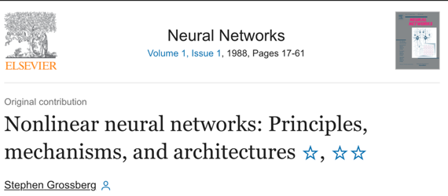

Neuronal activity models
Lapicque (1907)
Adrian (1926)
McCulloch & Pitts (1943)
Hodgkin & Huxley (1952)
Amari (1972)
Little (1974)
Wilson & Cowan (1972)
Cohen & Grossberg (1983)
Hopfield (1982 & 1984)
…
Characterized as continuous-nonlinear, firing-rate or rate-based models

Slide 6
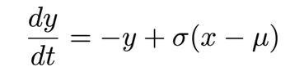
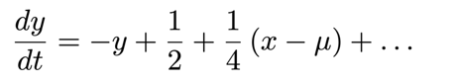
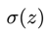
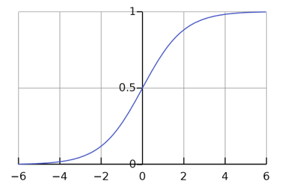
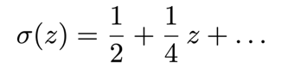
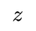
Neuronal activity models
Lapicque (1907)
Adrian (1926)
McCulloch & Pitts (1943)
Hodgkin & Huxley (1952)
Amari (1972)
Little (1974)
Wilson & Cowan (1972)
Cohen & Grossberg (1983)
Hopfield (1982 & 1984)
…
Linear regime
Threshold
Activation function

Slide 7
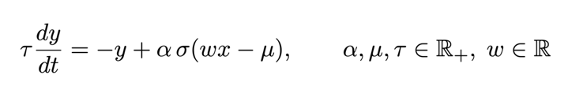
Neuronal activity models
Lapicque (1907)
Adrian (1926)
McCulloch & Pitts (1943)
Hodgkin & Huxley (1952)
Amari (1972)
Little (1974)
Wilson & Cowan (1972)
Cohen & Grossberg (1983)
Hopfield (1982 & 1984)
…
Threshold
Threshold
Weight
Activation amplitude

Slide 8
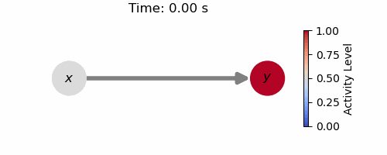
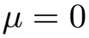
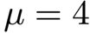
Neuronal activity models
Lapicque (1907)
Adrian (1926)
McCulloch & Pitts (1943)
Hodgkin & Huxley (1952)
Amari (1972)
Little (1974)
Wilson & Cowan (1972)
Cohen & Grossberg (1983)
Hopfield (1982 & 1984)
…

Slide 9
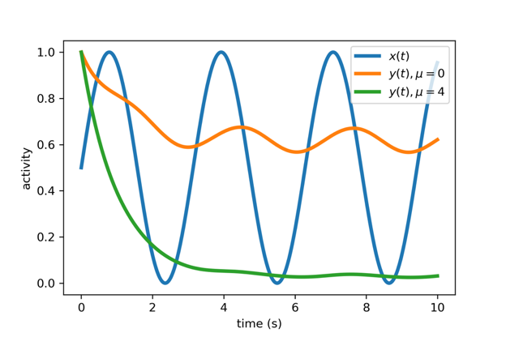
Neuronal activity models
Lapicque (1907)
Adrian (1926)
McCulloch & Pitts (1943)
Hodgkin & Huxley (1952)
Amari (1972)
Little (1974)
Wilson & Cowan (1972)
Cohen & Grossberg (1983)
Hopfield (1982 & 1984)
…

Slide 10
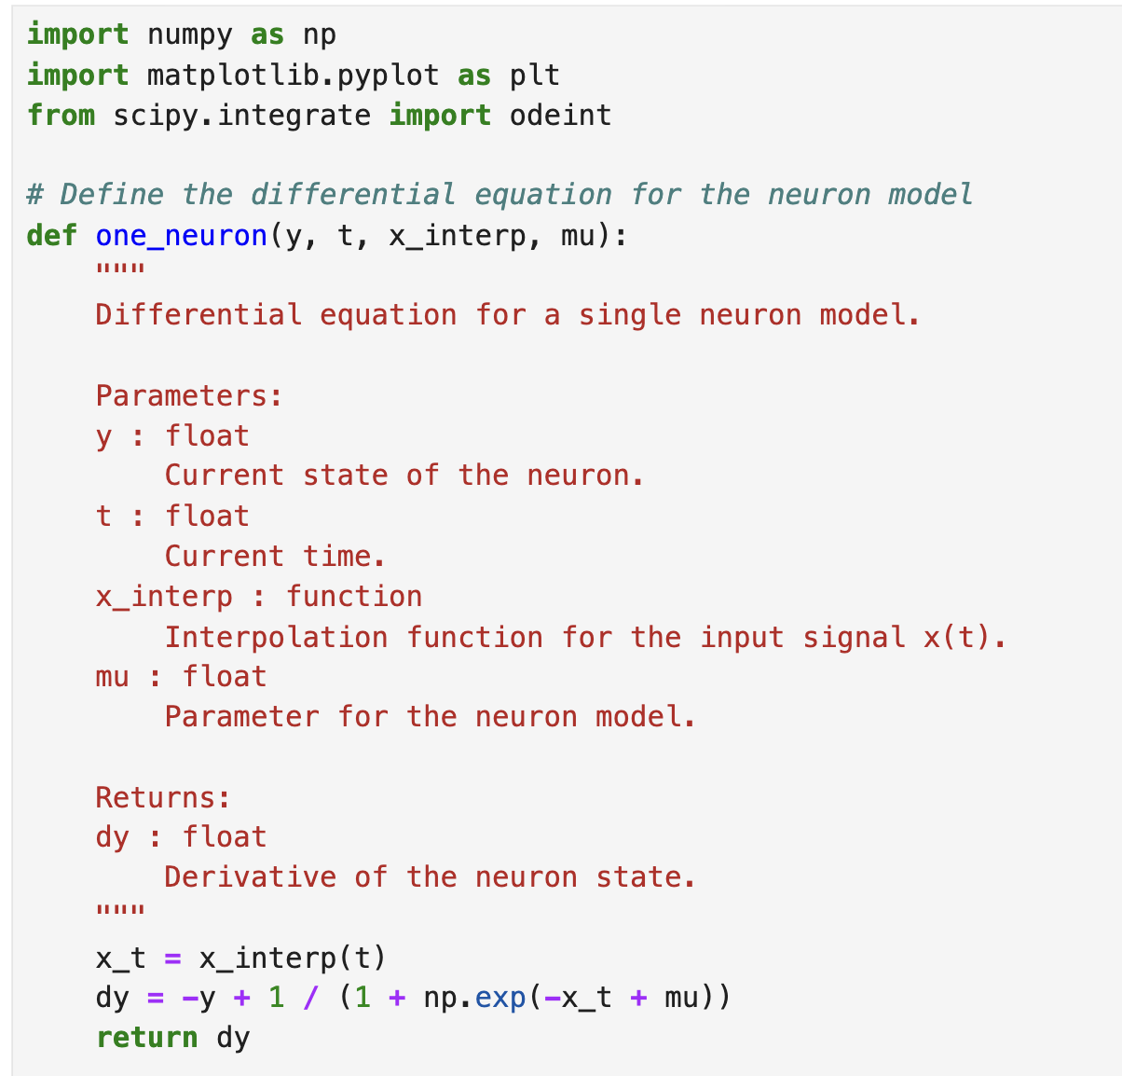

Slide 11
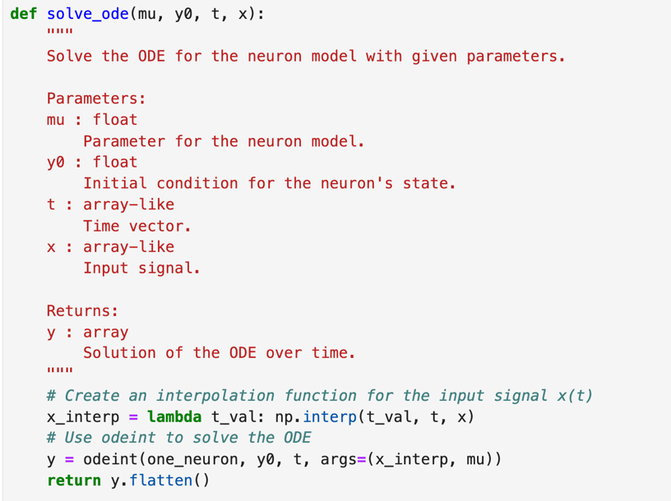

Slide 12
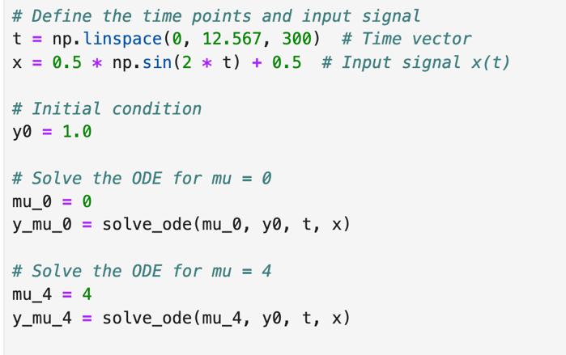

Slide 13
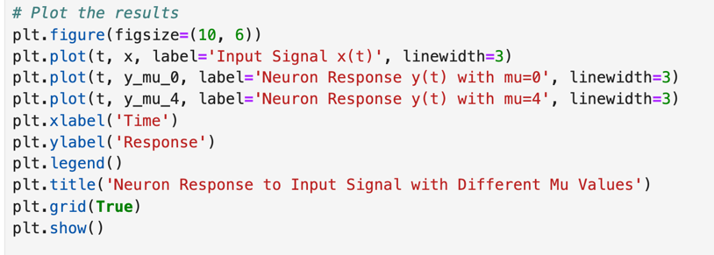

Slide 14
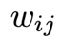
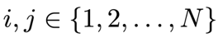
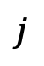
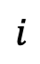
Network activity model
$$j$$
$$i$$

Slide 15
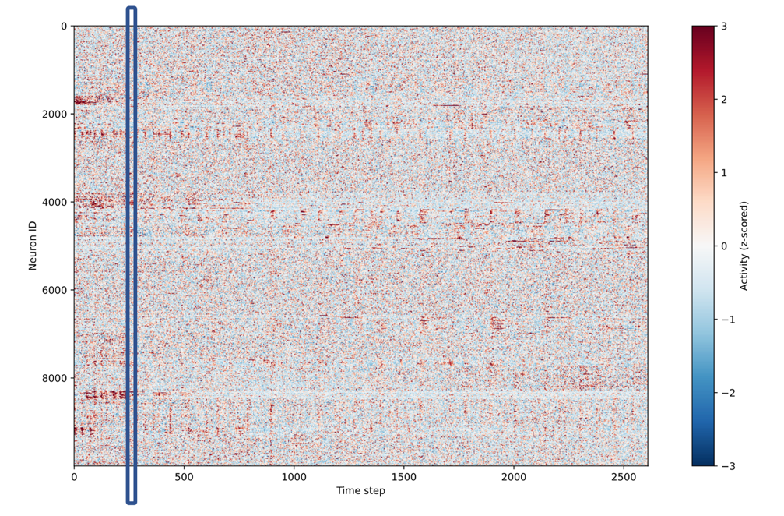

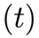
Network state at time t:

Slide 16
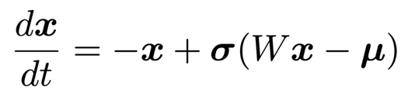
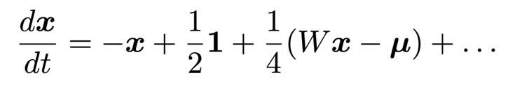
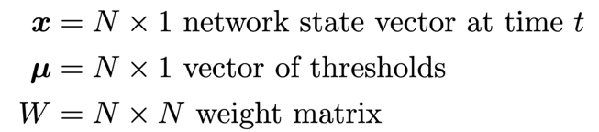
Network activity model
Linear regime
$$j$$
$$i$$
This is a complex dynamical system:
high dimensional, heterogeneous, and nonlinear.
This is a complex dynamical system:
high dimensional, heterogeneous, and linear.

Slide 17



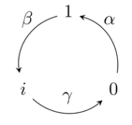
Network activity model
$$j$$
$$i$$
This deterministic dynamical system emerges from the stochastic response of neurons to stimuli.
active
refractory
sensitive

Slide 18
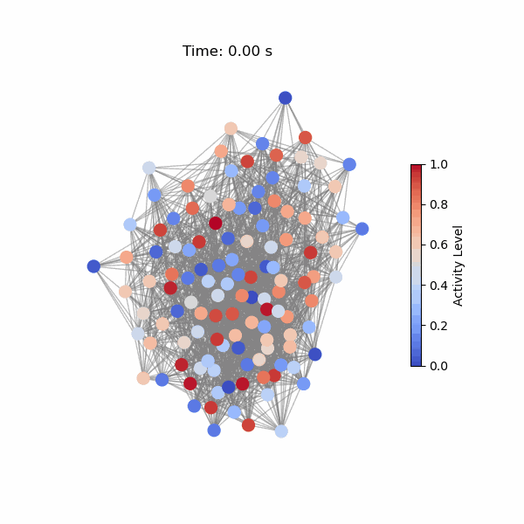
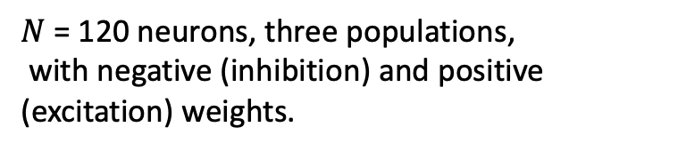
Network activity model:
Simple nonlinear example
$N$ = 120 neurons, three populations,
with negative (inhibition) and positive (excitation) weights.
W =

Slide 19

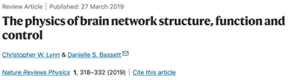

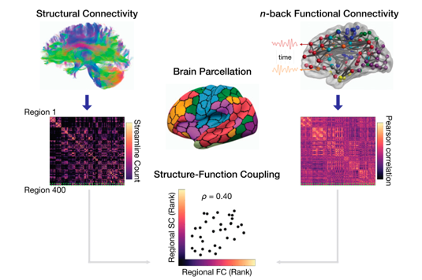


Structure-function relationship:
A fundamental concept in in neuroscience
The Structure-function relationship essentially boils down to two fundamental questions:
How does brain structure influence its activity?
How does observing its activity predict its structure?
It has been extensively studied since the emergence of Network Neuroscience.
Baum et al. PNAS 2020

Slide 20
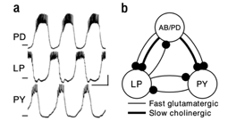
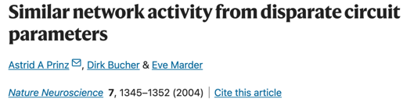

Two important lessons from neuroscience and network science:
1. Many structures produce the same function.
Pyloric rhythms of the crustacean stomatogastric ganglion and a simplified version of underlying neuronal circuit.
The main result of our analysis of the database of over 20 million network models is that similar network outputs can be generated with a large variety of combinations of synaptic strengths and intrinsic neuronal properties.
The true topology is not needed for predicting dynamics on networks, since the dynamics evolve in a subspace of astonishingly low dimension compared to the size and heterogeneity of the graph.

Slide 21

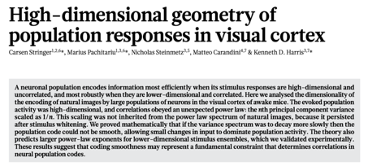
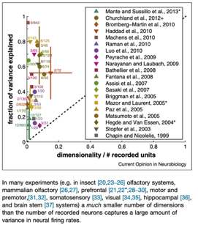
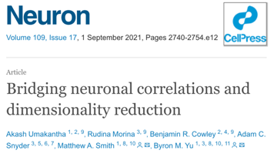



Two important learned lessons from neuroscience and network science:
2. Neuronal activity lies on a low-dimensional manifold

Slide 22
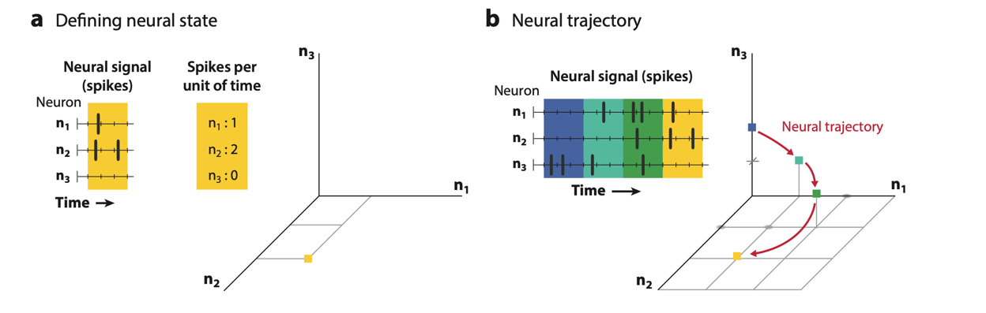
What is the space of the neuronal activity ?
Vyas et al. Annu. Rev. Neurosci. 2020.
In principle, the activity (firing rate) of N neurons spans a space of dimensionality N.

Slide 23
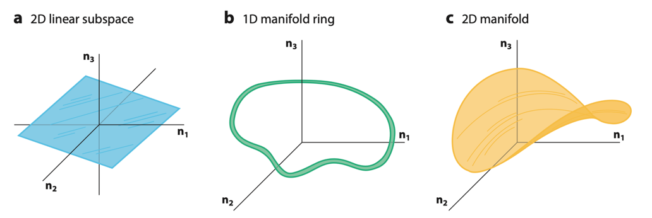
What is the dimension of the neuronal activity ?
Vyas et al. Annu. Rev. Neurosci. 2020.
In a real neuronal network, we expect the dimensionality for $N$ neurons to be n $≪N$.

Slide 24
We now go to the Colab notebook to study in details simpler nonlinear network models

